Slide 1



python mini project
weather app in python using tkinter and weather api
by:
Tharun BP ENG20CY0041
P Kushal ENG20CY0024
Ezra ENG20CY0009
Nainesh Dalai ENG20CY0049

Slide 2
introduction:
The project consists of a simple weather app with GUI written in python using tkinter, requests and json packages.
The tkinter package lets us to create a simple GUI using python with few lines of code
The requests package is for accessing the weather info from weather api at weatherapi.com using an api key
the json module converts the raw response data from the weatherapi which is in json format to a dictionary data type for easier use of data

Slide 3
info on libraries used:
tkinter: tkinter is a python library thats included in python by default and is used to create simple GUI(graphical user interfaces) using widgets like elements that are predefined in the tkinter library
requests: requests is a python library that is used to send HTTP web requests to a specific URL, which in this case is used to make a GET request to api.weatherapi.com for getting the weather data

Slide 4
info on libraries used(contd):
json: json stands for javascript object notation is a light weight data interchange format that is used for exchanging data between computers or programs it is similar to that of a dictionary data type that exists in python where you can have key value pair and each can have any data type
which is more efficient compared to plain text format.
data that is in json format can be used in python using the built in json package

Slide 5
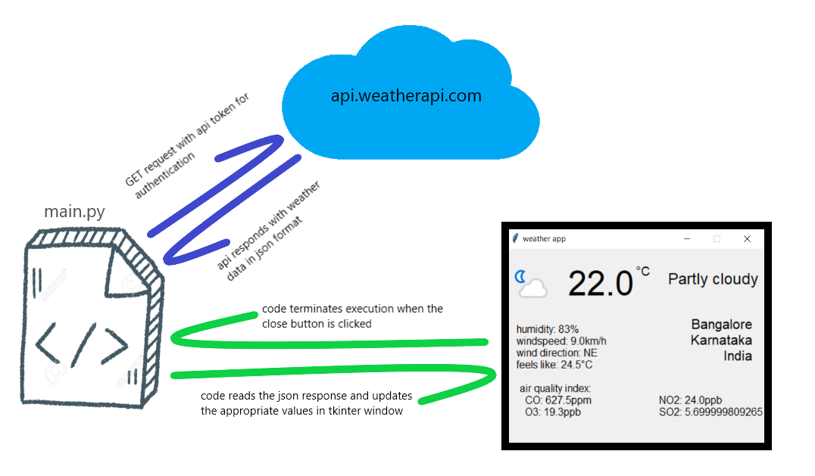
how it works:

Slide 6
requirements:
os: any modern os(windows 7 or later, macos, linux(debian,ubuntu,rhel))
ram:1gb and above
processor:Processors: Intel Atom® processor or Intel® Core™ i3 processor and above
python version 3.7.x and above
disk space: 5gb and above

Slide 7
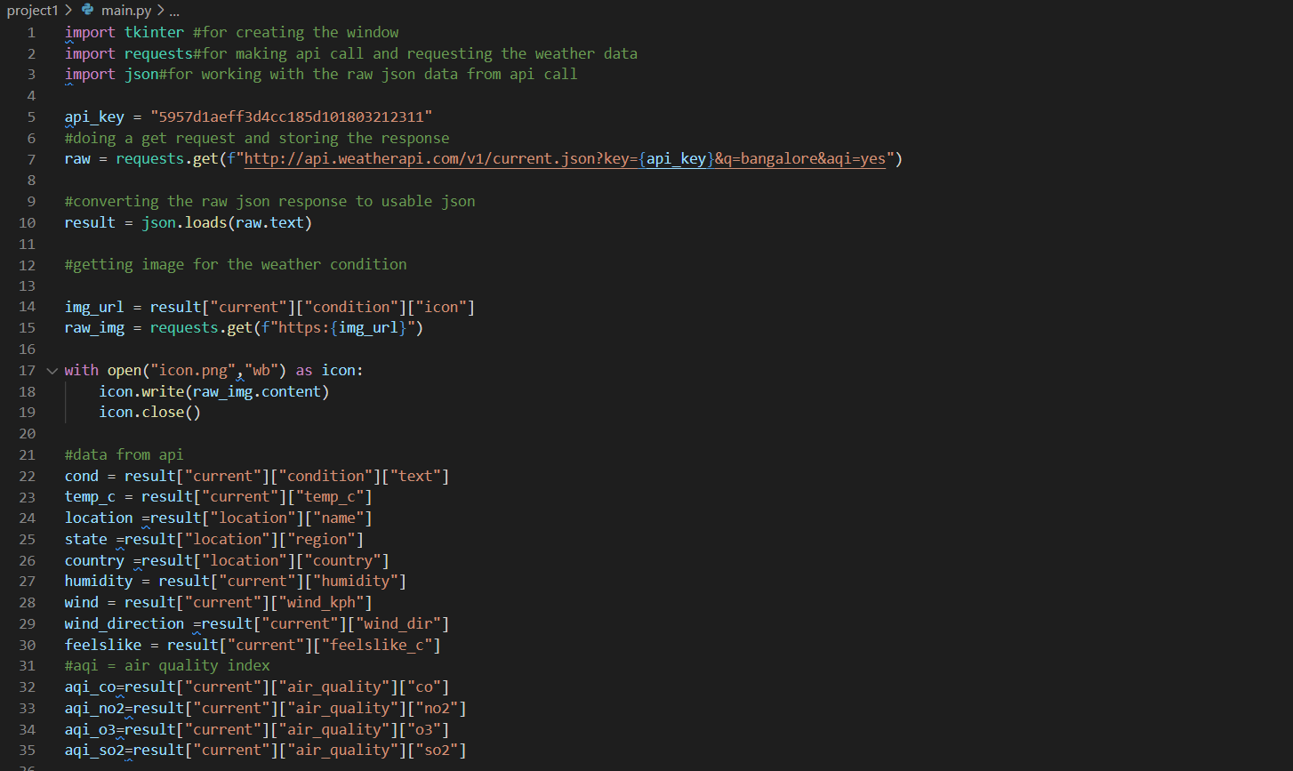
code(1):

Slide 8
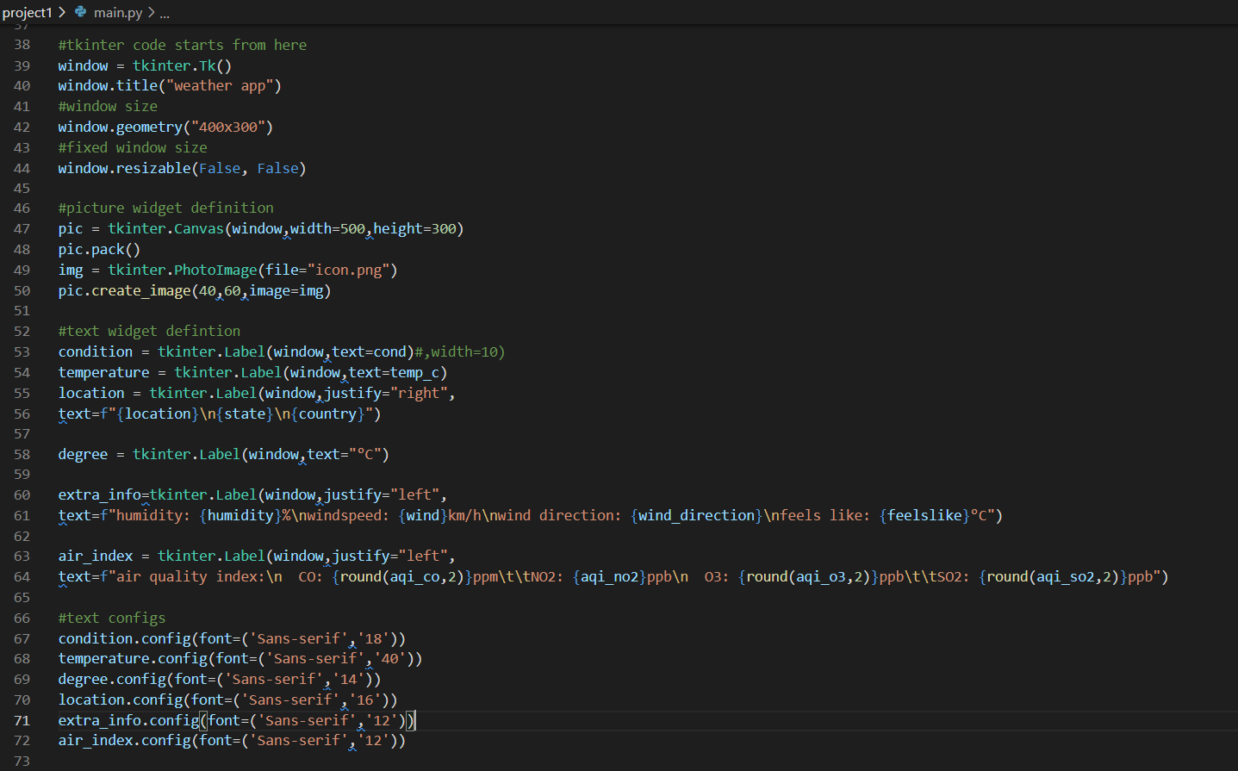
code(2):

Slide 9
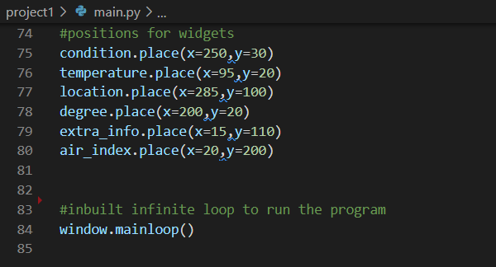
code(3):

Slide 10
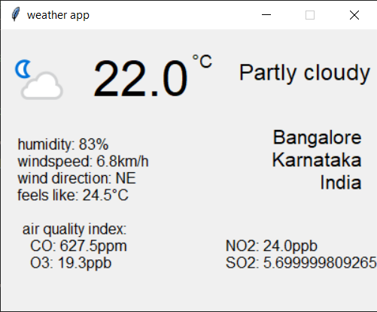
output:

Slide 11
references:
https://www.tutorialspoint.com/python/python_gui_programming.htm
https://www.geeksforgeeks.org/python-requests-tutorial/
https://www.w3schools.com/python/python_json.asp
the code for the project is hosted at:
https://github.com/ctpyproject/project1

Slide 12
Thank
you!

